Slide 1

GRU-TemporalAttention Model with Time Series Decomposition Module for Battery Fault Diagnosis in Quadrupedal Robots
Quadrupedal robots may face battery degradation, posing safety risks. Therefore, a fault diagnosis method is crucial for safe operation. We propose a neural network and self-adaptive dynamic threshold for this purpose.
Author: Xiaolong Chen
Central South University
ICIT 2024
Notes:
尊敬的专家、学者下午好，我是来自中南大学的陈晓龙。下面我将分享的论文是《k》。这篇论文主要是解决足式机器人中的电池故障诊断问题。
Good afternoon respected experts and scholars, I am Xiaolong Chen from Central South University. The paper I will be presenting is titled "k". This paper mainly addresses the issue of battery fault diagnosis in Quadrupedal robots.

Slide 2
Outline
Background and Motivation (1min)
Battery Pack and Dataset (1min)
Problem Analysis and Solution (2min)
Methodology (5min)
Neural Network
Self-adaptive Dynamic Threshold
Results Analysis and Discussion (2min)
Notes:
我将从Background and Motivation、Battery Pack and Dataset、Problem Analysis and Solution、Methodology 、Results Analysis and Discussion这五个部分进行介绍。
I will introduce from Background and Motivation, Battery Pack and Dataset, Problem Analysis and Solution, Methodology, to Results Analysis and Discussion.

Slide 3
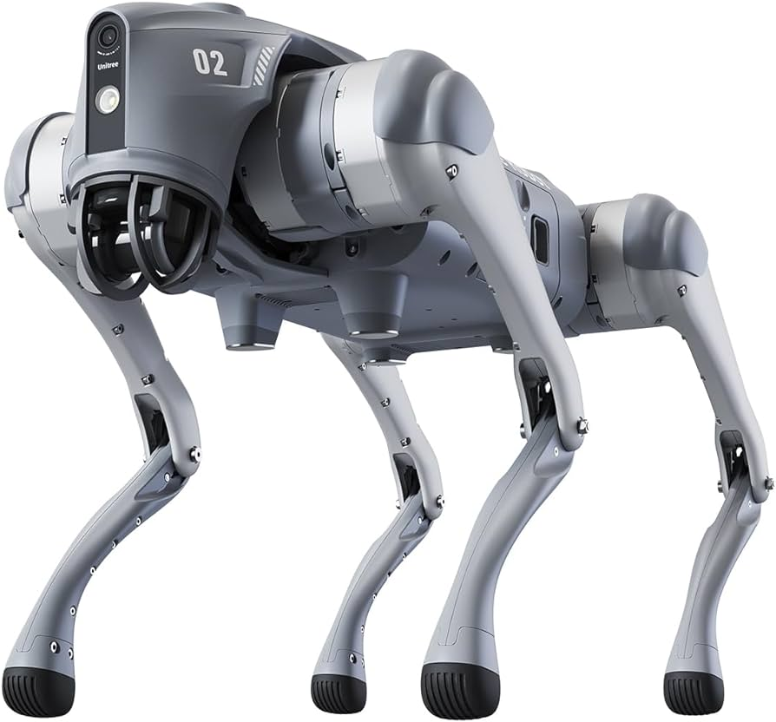
Background and Motivation
Due to the dynamic work conditions of quadrupedal robots, the performance of batteries could be degraded and further cause serious safety issues.
Therefore, it is crucial to design a feasible fault diagnosis method to ensure the safe and efficient operation of robots.

Slide 4
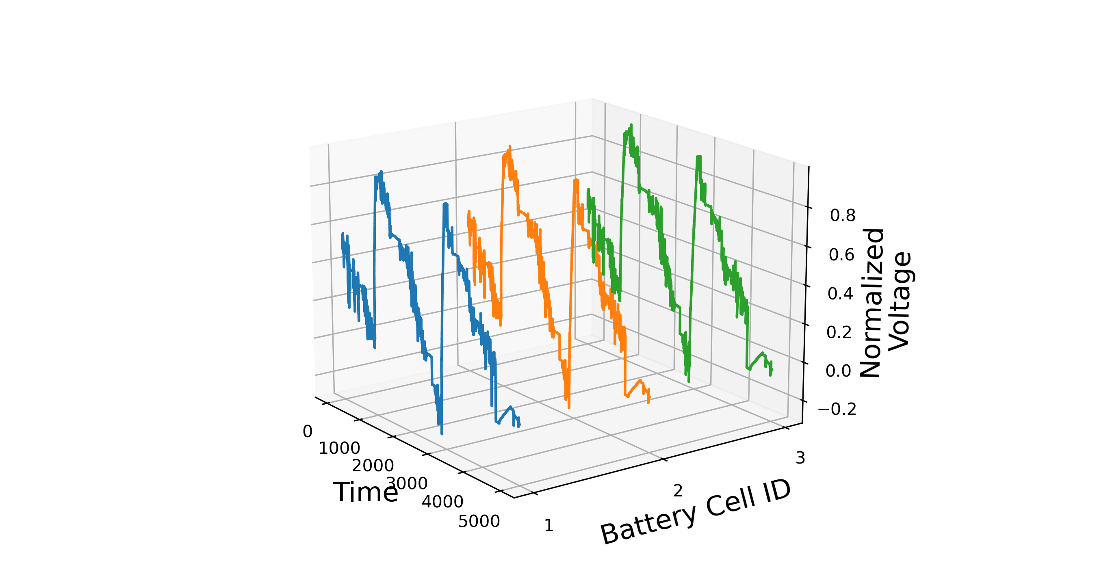
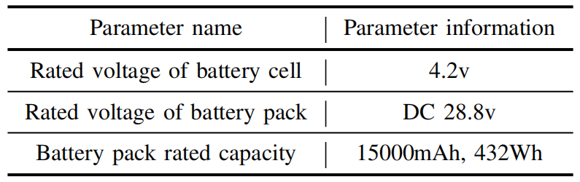
Battery Pack and Dataset
This dataset comprises voltage collected from the battery pack of a quadruped robot, where each pack is composed of 7 battery cells in series. Basic information about the battery pack and individual cells is provided in the table below.
The three-dimensional graph on the left displays voltage data of three battery cells within a certain battery pack.
Notes:
本文机器人使用的电池包由七个电池单体串联组成，电池包的基本信息如表所示。本文数据集为从电池包中采集的各个电池的电压数据。
The battery pack used in this robot consists of seven battery cells connected in series. The basic information of the battery pack is provided in the table below. The dataset used in this paper consists of voltage data collected from each battery cell within the battery pack.

Slide 5
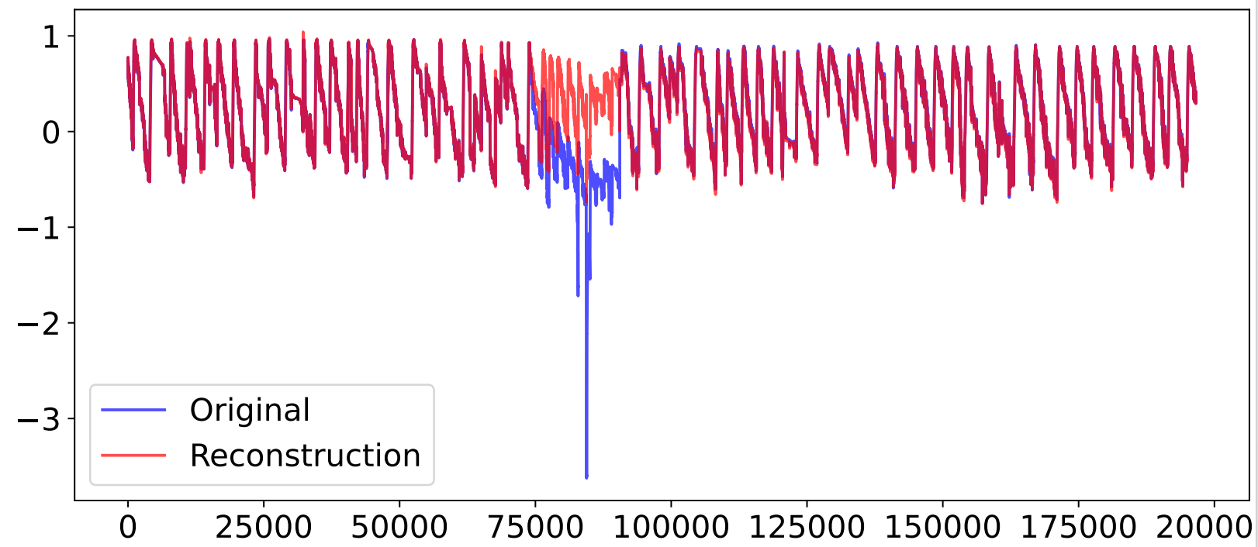
Problem Analysis and Solution
Problem Analysis
Battery fault causes significant changes in data distribution, which can be detected by thresholding. However, it is more important to predict the fault before it happens, based on subtle data changes. Data-driven methods can address this challenge.
Notes:
We can use Data-driven methods to address this challenge.

Slide 6
Problem Analysis and Solution
Data-driven methods predict battery fault
Unsupervised learning of the model using data from normal battery operation, with model inputs as training labels, to learn the distribution of normal data.
When a battery fails, the data distribution changes, making it difficult for the model to reconstruct the original data, leading to increased reconstruction error.
When the error exceeds a threshold, a fault is indicated.
Comparison of original and reconstructed data in the battery fault region.
Notes:
Data-driven methods predict battery fault before failure happened.

Slide 7
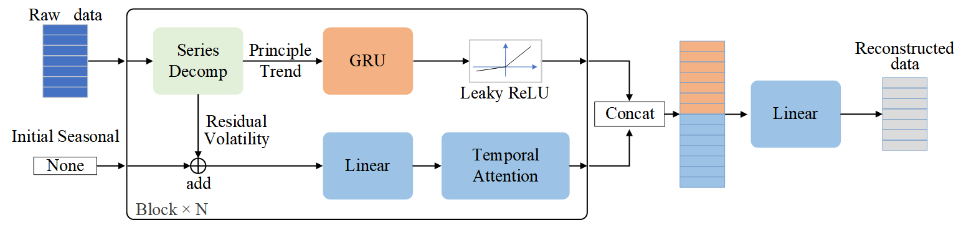
Methodology
Neural Network
Self-adaptive Dynamic Threshold
Notes:
方法部分将介绍本文提出的神经网络和自适应动态阈值
In the Methodology section, I will introduce the neural network and self-adaptive dynamic threshold proposed in this paper.

Slide 8
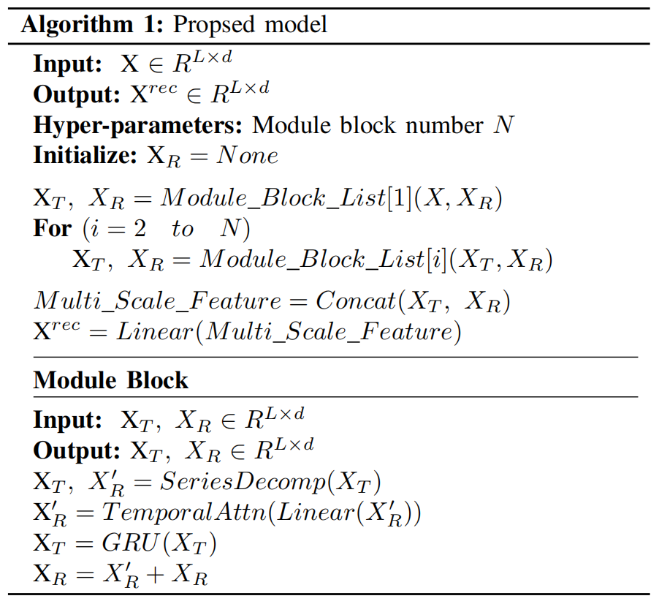
Methodology - GRU-TemporalAttention Model with Time Series Decomposition Module
Raw data and initialized residual term enter basic block initially.
If multiple modules are stacked, trend components and residual terms re-input into blocks separately.
Trend component and residual term concatenated and input into linear layer to obtain reconstructed data.
Notes:
这里将介绍神经网络的整体架构和运行过程。原始数据和初始化残差项进入基本模组。在基本模组中数据将被分解为趋势项和残差波动项，趋势项由上方的GRU模块学习，残差项和初始信息相加，然后由线性层和时序注意力机制学习。若存在多个模组堆叠，则趋势项和残差项分别再次输入到模组中。最后将趋势项和残差项拼接输入线性层得到重构的数据。
We will introduce the overall architecture and operation process of the neural network. The raw data and initialized residual term enter the basic block initially. Within this block, the data is decomposed into trend component and residual term. The trend component are learned by the GRU module above, while the residual term are added to the initial information, and then learned by a linear layer and a temporal attention mechanism. If multiple blocks are stacked, the trend component and residual term are re-input into the bolcoks separately. Finally, the trend component and residual term are concatenated and input into a linear layer to obtain the reconstructed data.

Slide 9
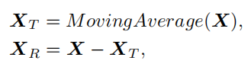
Methodology - GRU-TemporalAttention Model with Time Series Decomposition Module
Series Decomposition:
Applies sliding window moving average to extract trend term from data.
Subtracts trend term from original data to obtain residual term.
GRU: Abbreviation for Gated Recurrent Unit.
Linear: Represents the basic fully connected layer.
Temporal Attention: Application of attention methods in the time dimension.
Notes:
这里将介绍模型中的模块细节。
Here I will introduce the module details in the block.

Slide 10
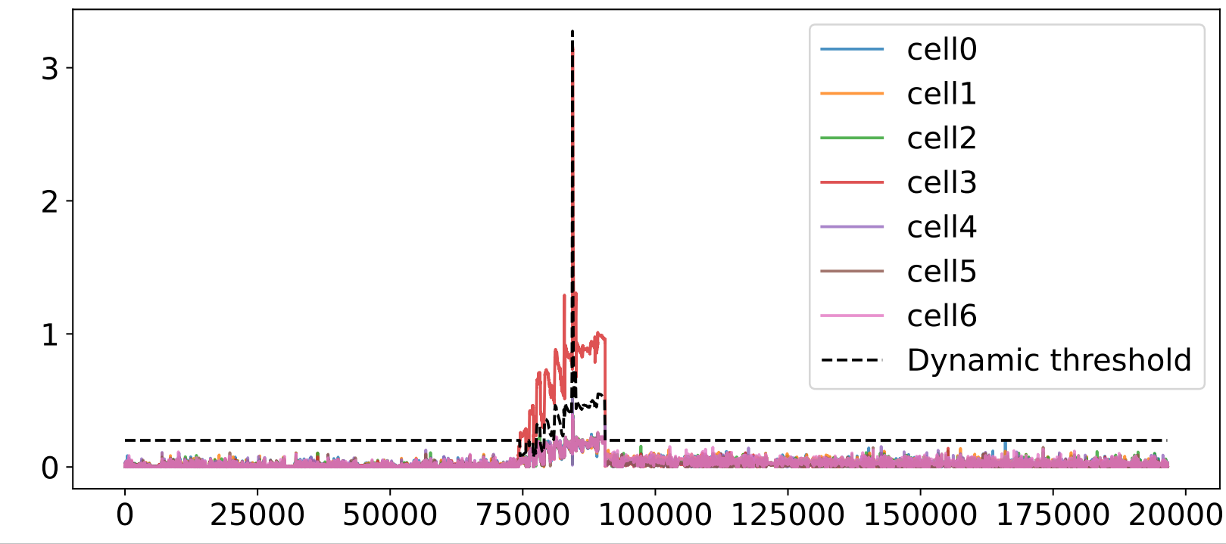
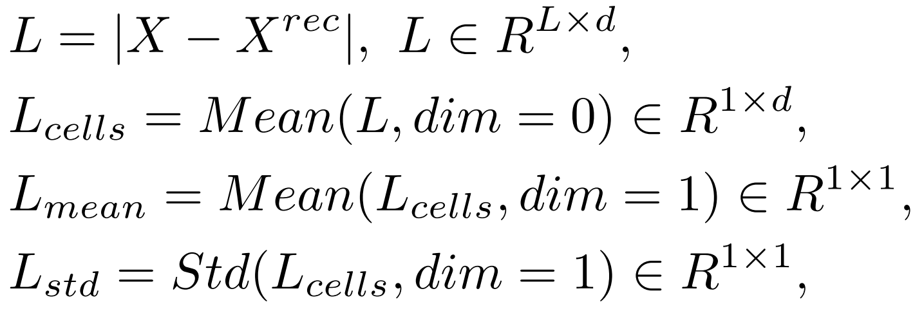
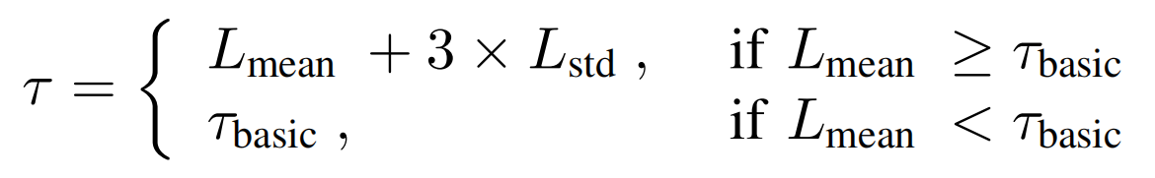
Methodology Self-adaptive Dynamic Threshold
To reduce the misdiagnosis rate in fault diagnosis relying on fixed thresholds, an adaptive dynamic threshold method based on battery cell consistency is proposed in this paper.
The reconstruction errors of the seven battery cells in the battery pack.
Notes:
传统的固定阈值容易造成误诊断，本文基于电池单体的一致性，设计了自适应的动态阈值τ，该方法可以显著减少故障诊断的误判率。
自适应阈值的计算方法如右侧公式所示，首先，分别计算电池包中七个电池的重构误差，然后计算它们的重构误差的均值和方差。如果电池包的平均重构误差大于基础阈值，则使用3σ法则得到最后的动态阈值。
如图所示为电池包中7个电池单体的重构误差，其中cell 5为发生故障的电池，如果仅使用固定阈值，则在故障时刻，其他电池的误诊断率会非常高。
Here I will introduce the Self-adaptive Dynamic Threshold proposed in this paper.
First, calculate the reconstruction errors of seven cells in the battery pack, and then calculate their mean and variance. If the mean value reconstruction error exceeds the baseline threshold, the final dynamic threshold is determined using the 3σ rule.
Among them, cell 5 is the faulty cell. If only a fixed threshold is used, the misdiagnosis rate of other cells will be very high at the time of failure.

Slide 11
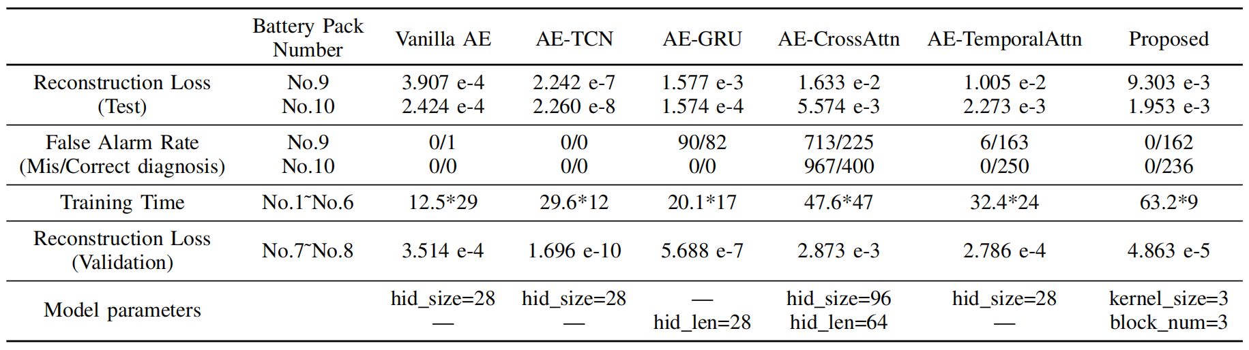
Results Analysis and Discussion
The model, dataset composition, loss, and misclassification rates used in this article are as shown in the table below:
Notes:
接下来将介绍实验结果与分析。本文使用了6个电池包作为训练集、2个电池包作为验证集、2个电池包作为测试集。实验结果如表所示，本文对比了5种不同的模型，结果表明本文模型可以很好的平衡误诊断和正确诊断。
The following will introduce the experimental results and analysis. This paper used six battery packs as the training set, two battery packs as the validation set, and two battery packs as the test set. The experimental results are shown in the table, comparing five different models. The results indicate that the model proposed in this paper can effectively balance misdiagnosis and correct diagnosis.

Slide 12
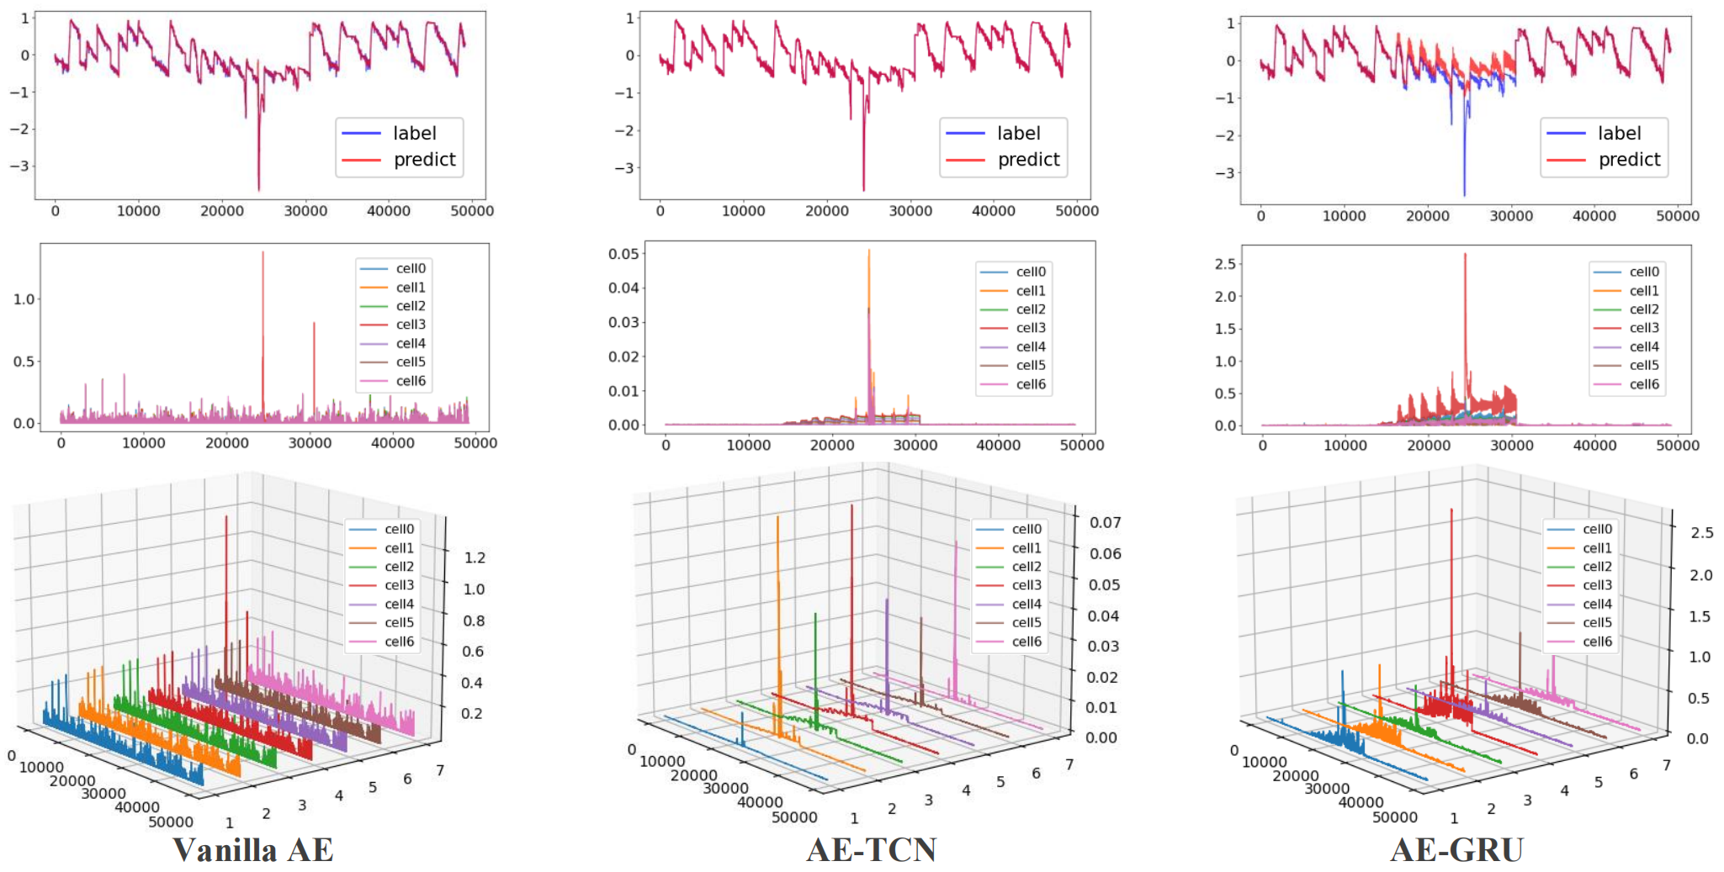
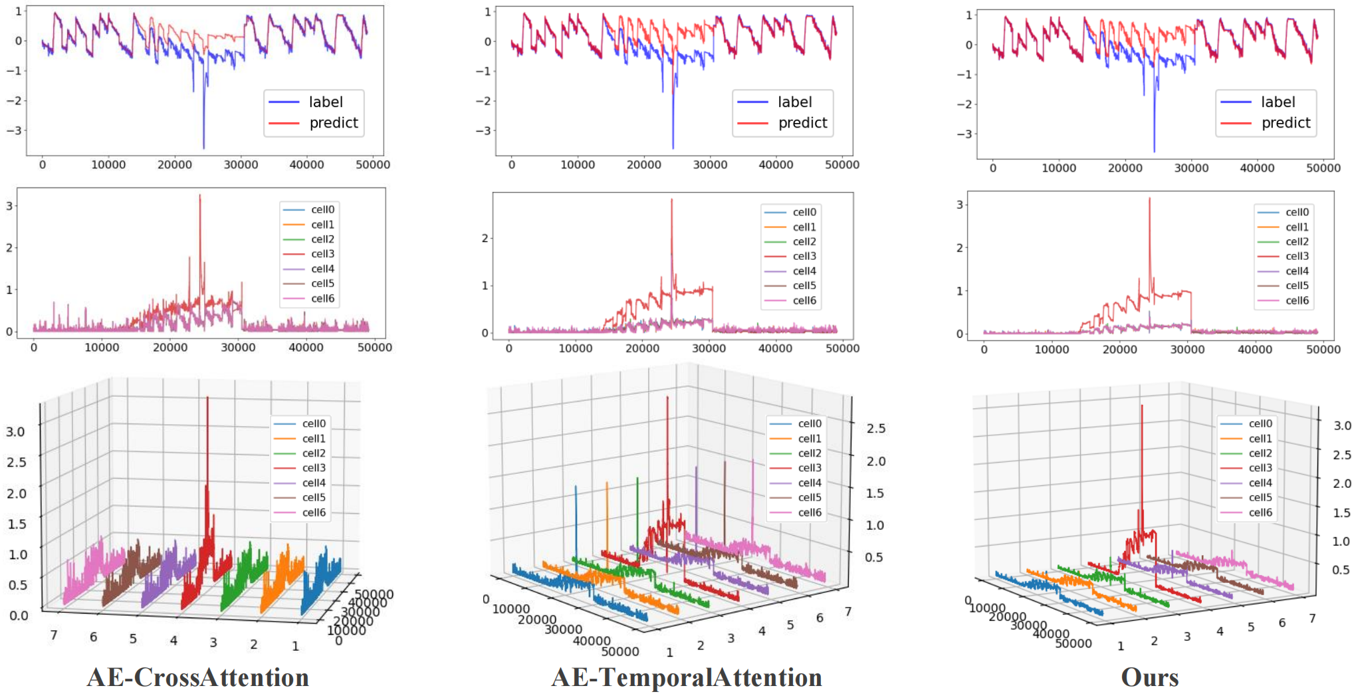
Results Analysis and Discussion
These images compare reconstruction results on faulty batteries across different models and depict the reconstruction loss for each battery cell voltage data.
The first row shows the actual voltage and its reconstructed voltage for the faulty battery, while the second and third rows illustrate the reconstruction loss for the voltage of the seven cells in the battery pack in both two-dimensional and three-dimensional plots.
Notes:
这些图片表示不同模型在的故障电池上的重构结果对比，以及对各电池单体电压数据的重构损失。其中，第一行表示故障电池的真实电压和其重构电压，第二行和第三行分别表示电池包在七个电池的电压的重构损失的二维图和三维图。
由图片可以看出，前两种模型无法区分电池的正常状态和异常状态，即对异常电压也能很好的重构。中间两种模型可以区分电池包的正常状态和异常状态，但是不能定位出哪个电池单体发生故障。而后两种模型，特别是本文提出的模型，可以明显区分出发生故障的电池与正常电池。
From the images, it can be observed that the first two models fail to distinguish between the normal and abnormal states of the battery, as they can reconstruct abnormal voltages effectively. The middle two models can differentiate between the normal and abnormal states of the battery pack but cannot identify which battery cell is faulty. On the other hand, the latter two models, especially the one proposed in this paper, can clearly distinguish between faulty and normal cells.

Slide 13
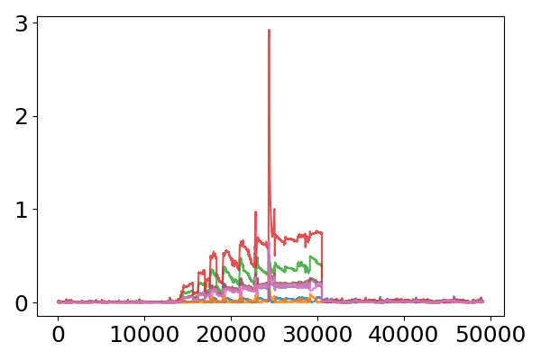
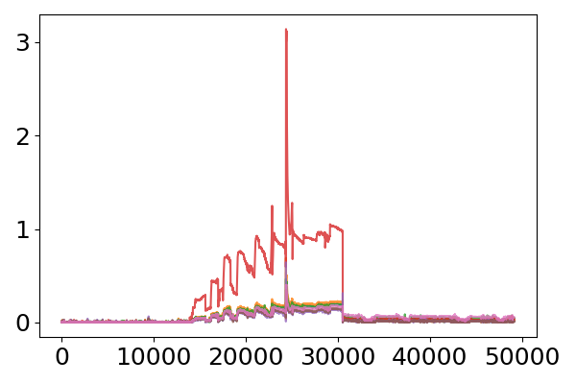
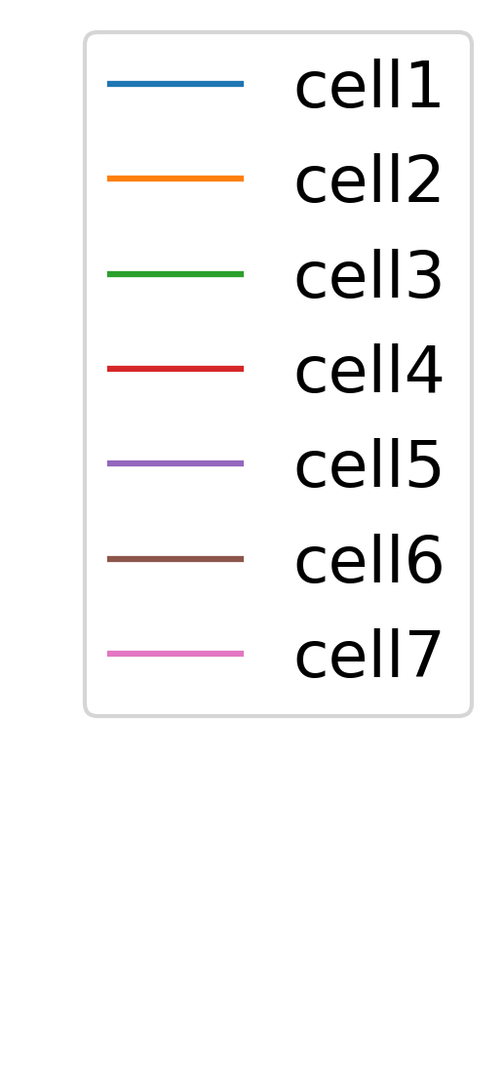
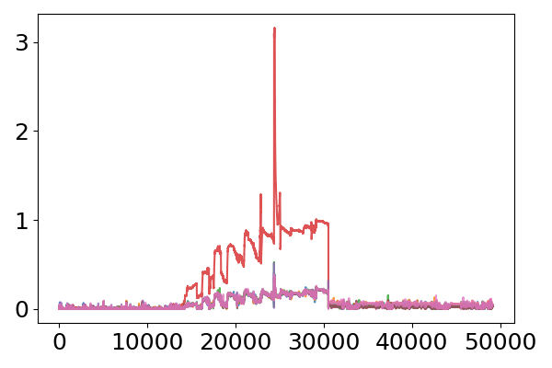
Results Analysis and Discussion
Block Effect Analysis
Comparing the reconstruction effects brought by models with different numbers of stacked blocks, it is evident that the more blocks are stacked, the stronger the ability to identify faults in battery cells.
Block num=1
Block num=2
Block num=3
Notes:
这里我们比较了提出的模块的性能。
表明堆叠该模块引入了渐进式的时序分解和辨别能力。
Here we compare the performance of the proposed block.
It indicates that stacking this block introduces progressive temporal decomposition and discrimination capabilities.

Slide 14
Thank you for your attention!
The relevant code and data for the article are available at the following link: https://github.com/CXL-edu/GRU-TAE-Temporal-Decomp-for-Battery-Fault-Diagnosis
Notes:
我的汇报到此结束，感谢。论文的代码和数据在下方链接中。
My presentation ends here, thank you.

